Slide 1
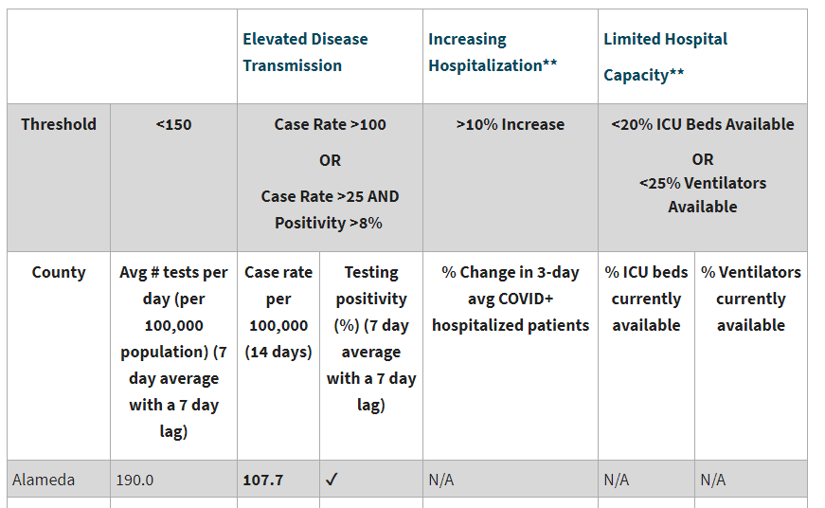
the state covid-19 watchlist
https://www.cdph.ca.gov/Programs/CID/DCDC/Pages/COVID-19/COVID19CountyDataTable.aspx

Slide 2
How we got on the watchlist
County of San Diego had an elevated case rate >100/100,000
July 1
State notifies COSD that “Case Rate” Metric is Elevated - Day 1
July 2
State notifies COSD that “Case Rate” Metric is Elevated – Day 2
July 3
State notifies COSD that “Case Rate” Metric is Elevated – Day 3
State Placed COSD on Public Watch List
To get on the Watch List, a county needs to meet the threshold in any one of the six data points for 3 consecutive days for to be placed on Public Watch List.
If/when we get off the Watch List, we can get back on if we pass any of the thresholds again.
Case Rate is an average, measured using date of illness onset with a 3-day lag for the 14-day case rate.
State definition of 14-day case rate: The total number of cases diagnosed and reported over a 14-day period divided by the number of people living in the county. This number is then multiplied by 100,000. Due to reporting delay, there is a 3-day lag. For example, a case rate calculated on April 1st would correspond to cases occurring from March 15th - March 28th. Although case rates are often calculated using the date they were reported to the health department, this measure uses the episode date. The episode date is the earliest of several dates and corresponds to the earliest date that the case can be known to have had the infection.
https://www.cdph.ca.gov/Programs/CID/DCDC/Pages/COVID-19/CountyMonitoringDataStep1.aspx

Slide 3
How we get off the watchlist
Case rate (14 day average) drops <100/100,000. COSD remains on State’s Watch List.
July 5
Continued “Good Data” Case rate <100/100,000. COSD remains on State’s Watch List
Targeted sectors per PHO begin opening. Schools* remain on distance learning.
14 days after being off the Watch List, COSD can reopen schools for in person instruction.
Day 1
Day 2
Day 3
Day 17
To
While it only takes 3 days to get ON the Watch List, it takes 3 to get OFF of it
On average, San Diego County would need to have 240 cases or less per day for 14 days (or less than 3,370 cases over 14 days) to have a 14 day case rate that would start the process to be removed from Watch List.
If/when we get off the Watch List, we can get back on if we pass any of the thresholds again so we must remain vigilant
*This does not apply to any elementary schools who have received waivers for in-person instruction*
https://www.cdph.ca.gov/Programs/CID/DCDC/Pages/COVID-19/CountyMonitoringDataStep1.aspx

Slide 4
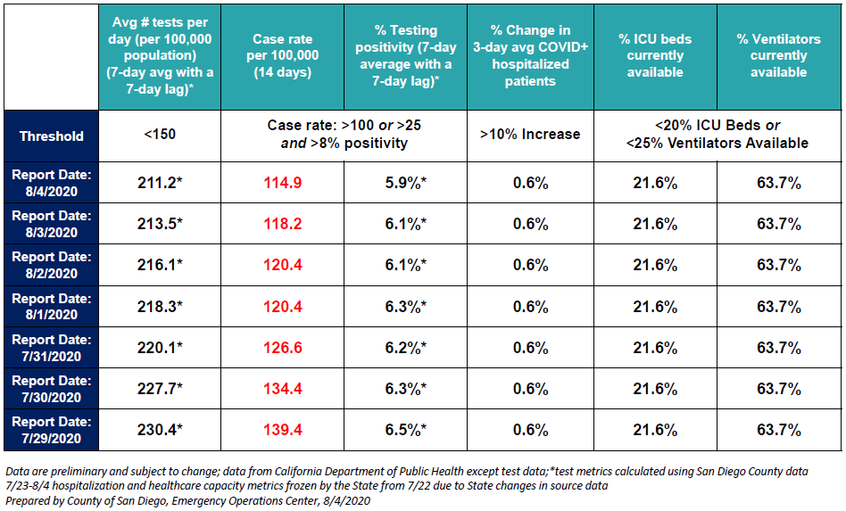
How we present this information daily
https://www.sandiegocounty.gov/content/dam/sdc/hhsa/programs/phs/Epidemiology/COVID-19_Daily_Status_Update.pdf

Slide 5
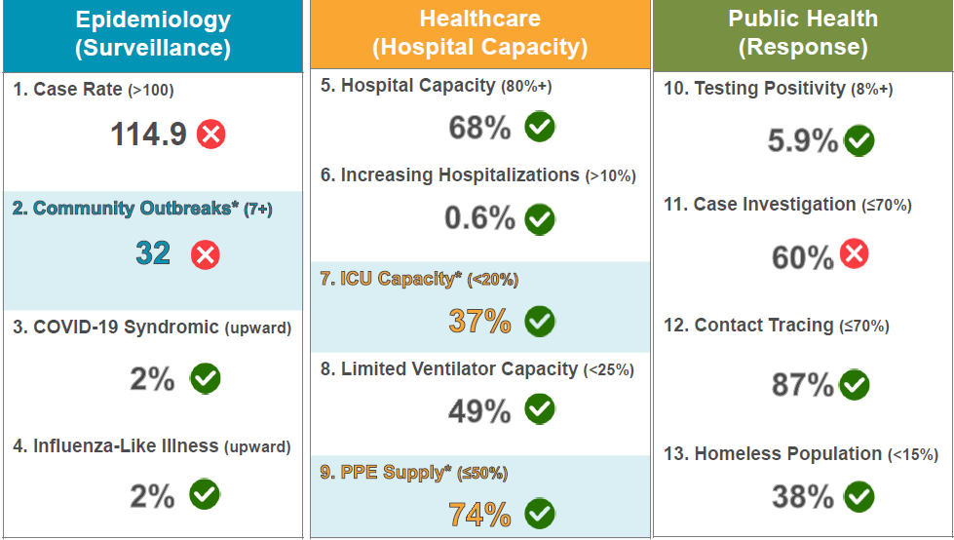
How we present this information daily
https://sdcounty.maps.arcgis.com/apps/opsdashboard/index.html#/30b5e0fa2a5f4404b1219d8cd16b2583

